Slide 1
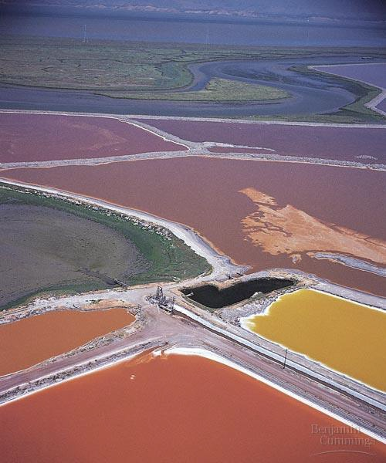
INTRODUCTION TO ALGAE
PPT for UG Students prepared by Dr. D. Barman, with the help from google, books and journals.

Slide 2
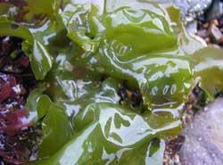
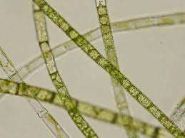
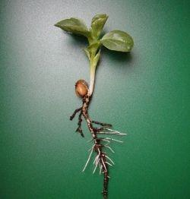
Algae vs. ‘REAL’plants
Similarities and differences:
•Both are photoautotrophic
•Similar metabolic functions to
higher plants eg. photosynthesis
•different anatomical structures,
•different reproduction.
•No true roots, stems leaves.
•Non-vascular, therefore nutrient uptake over surface. And wastes washed away from surface by aquatic environment
Slide prepared by Dr. D. Barman,Asst professor, Goalpara College

Slide 3
INTRODUCTION
Algae are chlorophil bearing organisms which are thalloid.
• They are important member in plant world.
• Plant body shows no differenciation into true tissues.
• It never forms true roots, stems and leaves.
• This plant body is called thallus.
• The thallus is non vascular and thus has a no element for the transport of fluids.
• They are active only in very most places.
Slide prepared by Dr. D. Barman,Asst professor, Goalpara College

Slide 4
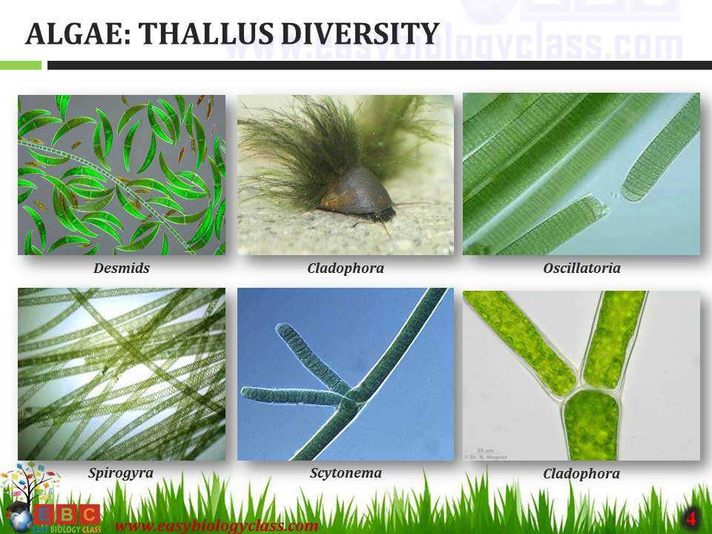
Algae: Thallus Diversity

Slide 5
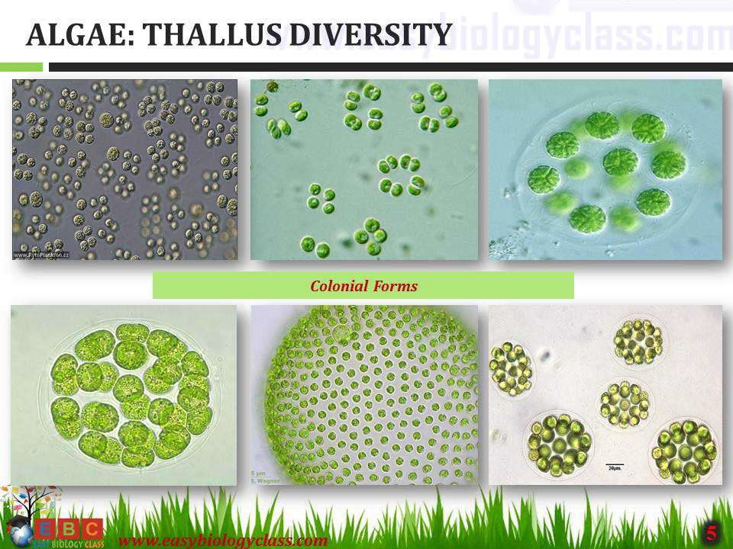

Slide 6
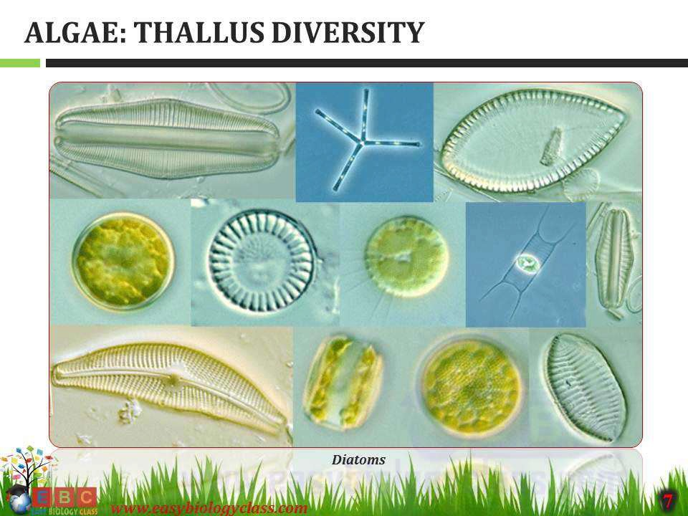

Slide 7
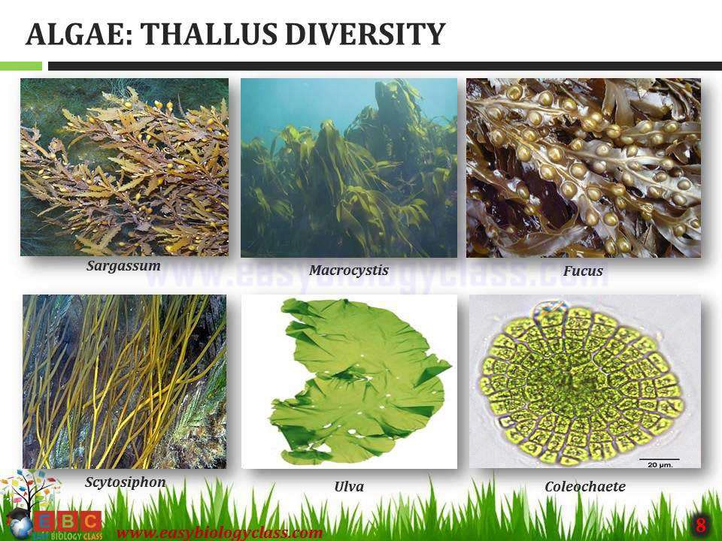

Slide 8
Habitat/Ecology of Algae
Algae are almost throughout the world,being most common in
aquatic and are found in fresh or salt waters.
•Algae can be categorized ecologically by their habitates as
follows .
Aquatic algae: Example:- Chlamydomonas.
Terrestrial algae : Example:- Fritschiella.
Aerophytes : Example:- Scytonema.
Cryophytes : Example:- Scotiella.
Thermophytes : Example:- Oscillatoria brevis.
Algae of unusual habit : Example:- Dunaliella
Slide prepared by Dr. D. Barman,Asst professor, Goalpara College

Slide 9
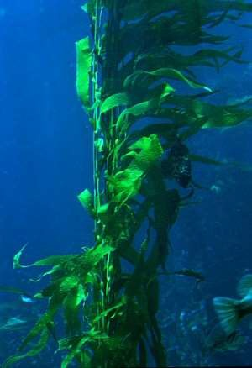
Habit and Habitat
Acquatic Algae
Found from tiniest ditch to the mightiest river and ocean.
Slide prepared by Dr. D. Barman,Asst professor, Goalpara College

Slide 10
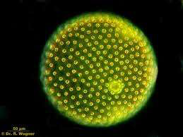
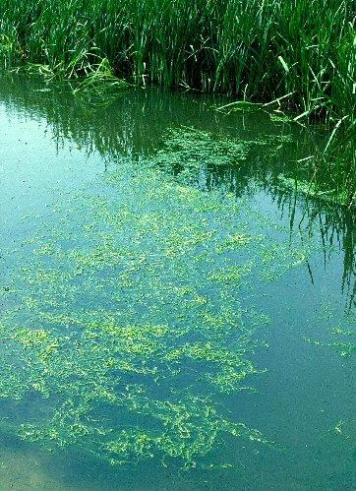
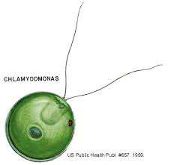
Fresh Water Algae
Volvox
Chlamydomonas

Slide 11
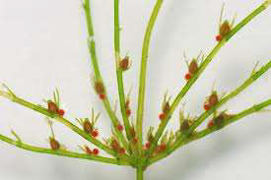
Stagnant water algae
Oedogonium
Chara

Slide 12
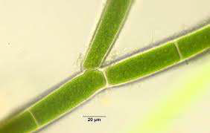
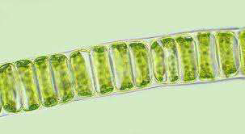
Running water algae
Ulothrix
Cladophora
Slide prepared by Dr. D. Barman,Asst professor, Goalpara College

Slide 13
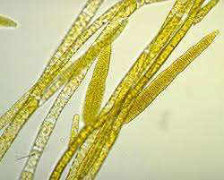
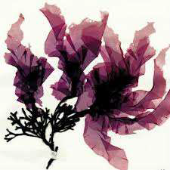
Sea Water Algae
Ectocarpus
Porphyra

Slide 14

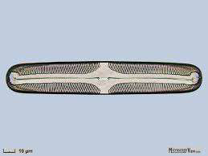
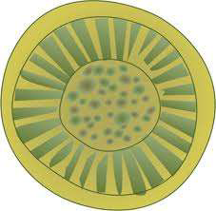
These are found free floating or freely swimming in water.
Diatom
Cyclotella
Slide prepared by Dr. D. Barman,Asst professor, Goalpara College

Slide 15

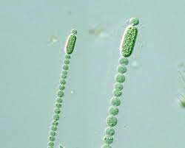
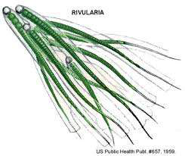
Beginning they gets attached but later they get detached.
Cylindrospermum
Rivularia
Slide prepared by Dr. D. Barman,Asst professor, Goalpara College

Slide 16
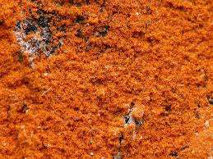
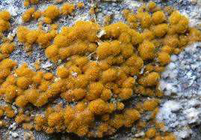
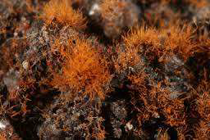
Terrestrial Algae
These are found on or beneath the soil surface. Example: Trentifolia sp.
Slide prepared by Dr. D. Barman,Asst professor, Goalpara College

Slide 17
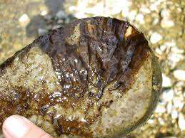
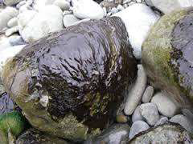
AEROPHYTES
They are adopted to the aerial life,occur on
tree trunks, moist walls, flower pots, rocks..etc
Phormidium

Slide 18
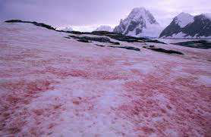
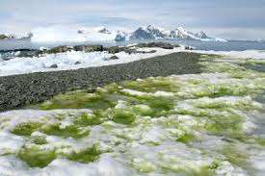
Cryophytes(snow algae)
Found on mountain peaks with snow.
Haemococcus nivalis
Chlamydomonas stonensis
( green Colour)

Slide 19
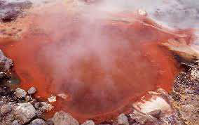
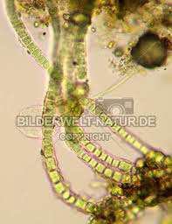
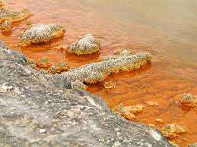
Thermophytes
Hot springs, tolerate temperature upto 85c.
Haplosiphon lignosus

Slide 20
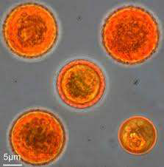
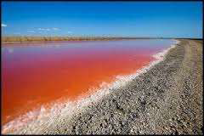
Halophytic Algae
They are present in water containing high
percentage of salt.
Haplosiphon salina

Slide 21
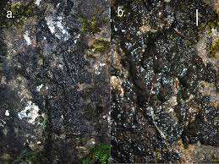
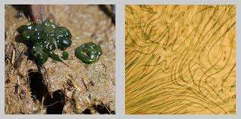
Lithophytes
Found on moist rocks and rocky surfaces.
Gleocapsa
Rivularia

Slide 22
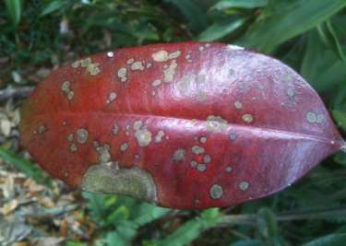
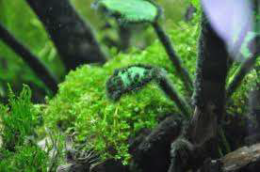
Epiphytic Algae
The algaes grow on other plants.
Ceplaleuros
Audourinella
Slide prepared by Dr. D. Barman,Asst professor, Goalpara College

Slide 23
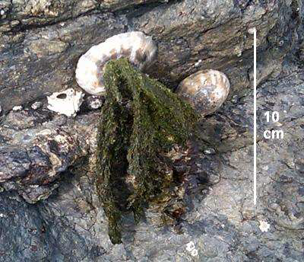
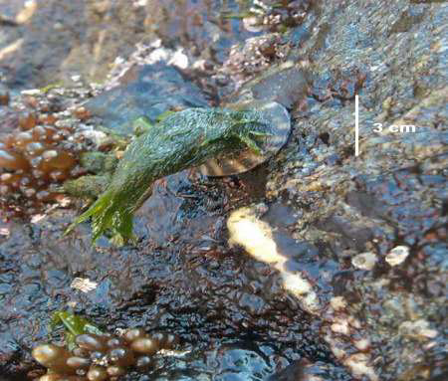
Epizoic Algae
These algaes are found on shells of molluscans, turtles and fins of fishes. Example: Acrosiphonia.

Slide 24
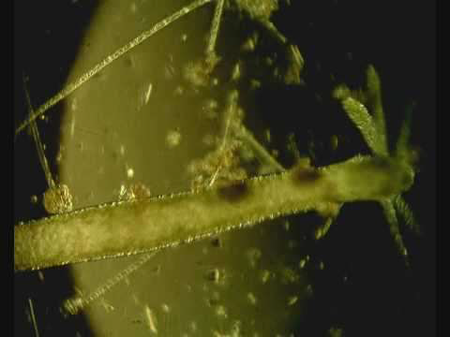
Endozoic Algae
These are found inside the body of aquatic animals.
Example: Zoochlorella found
inside the Hydra Viridis
Slide prepared by Dr. D. Barman,Asst professor, Goalpara College

Slide 25

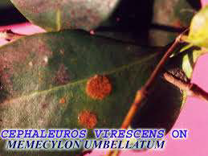
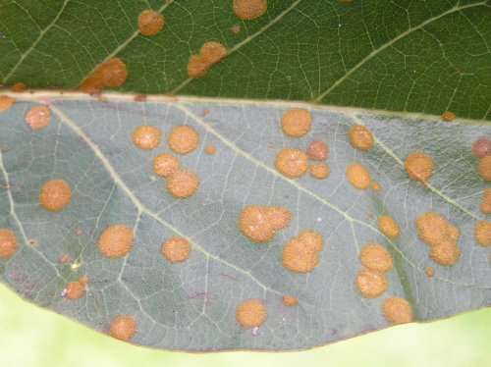
Eg: Cephaleuros virescens causes ‘ Red rust of tea’,by which a severe damage is caused.
Slide prepared by Dr. D. Barman,Asst professor, Goalpara College

Slide 26

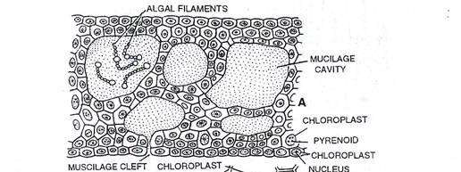
Many Cyanophycean members grow in symbiotic association with other plants.
Association of Nostoc
within thalli of Anthoceros.
Slide prepared by Dr. D. Barman,Asst professor, Goalpara College

Slide 27
Distribution
Algal abundance and diversity vary from one environment to the next.
• Abundance and diversity vary from tropical to deserts.
• Terrestrial vegetation is influenced most by precipitation and temerature .
• Aquatic vegetation is influenced by light and nutrients.
• When nutrients are abundant as in some polluted waters, algal cells numbers can become great enough to produce patches of algae called blooms.
Slide prepared by Dr. D. Barman,Asst professor, Goalpara College

Slide 28
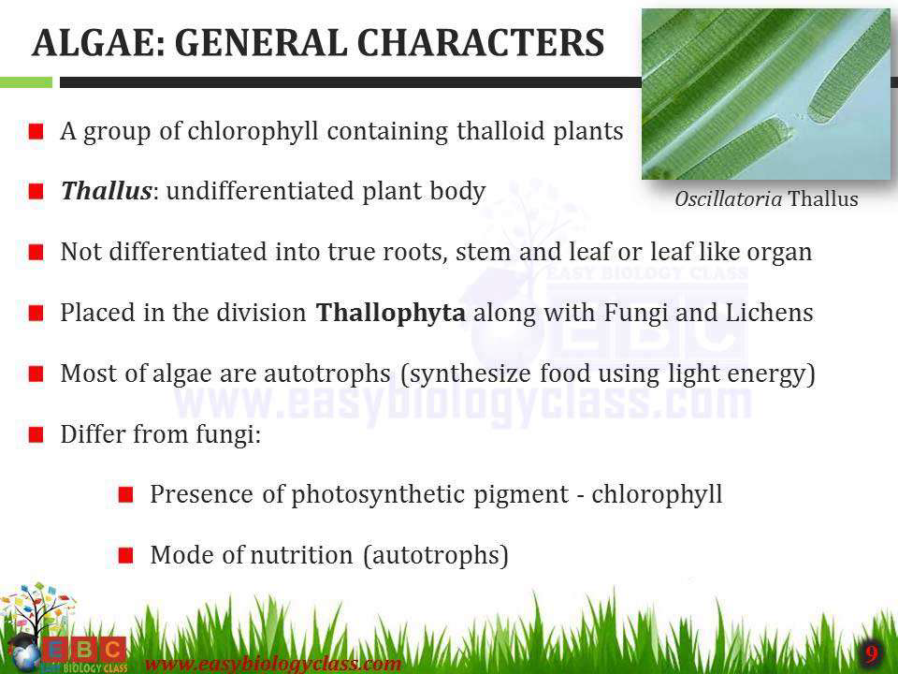
Slide prepared by Dr. D. Barman,Asst professor, Goalpara College

Slide 29
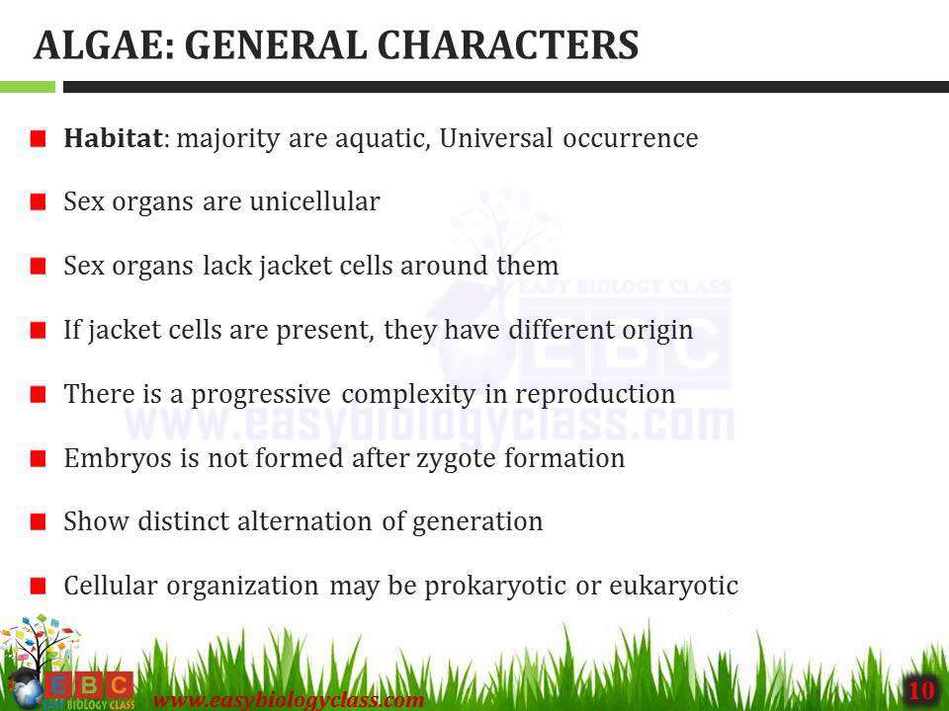
Slide prepared by Dr. D. Barman,Asst professor, Goalpara College

Slide 30
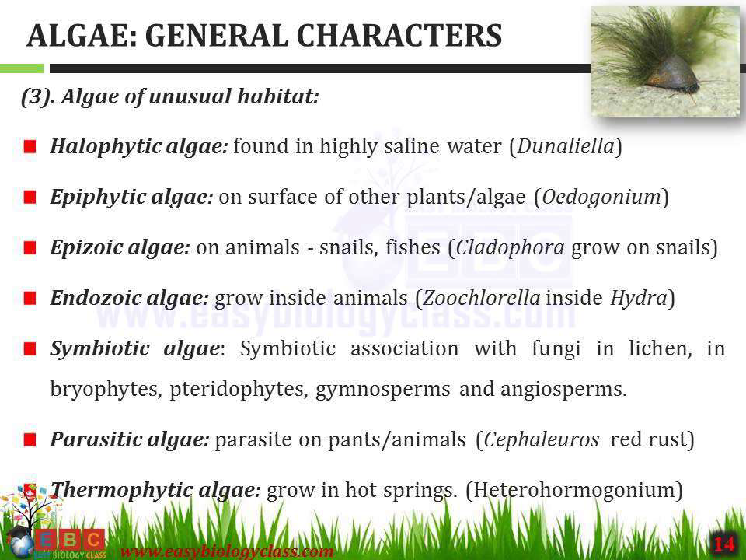
Slide prepared by Dr. D. Barman,Asst professor, Goalpara College

Slide 31
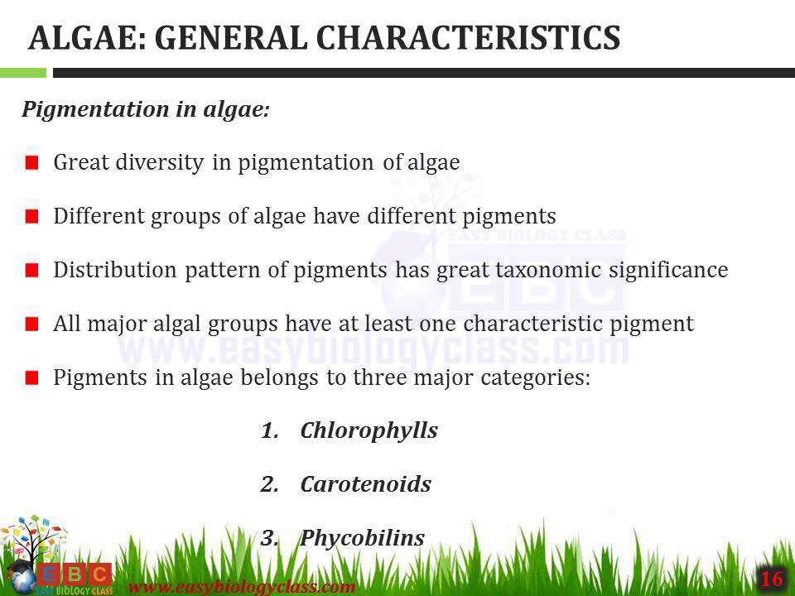
Slide prepared by Dr. D. Barman,Asst professor, Goalpara College

Slide 32
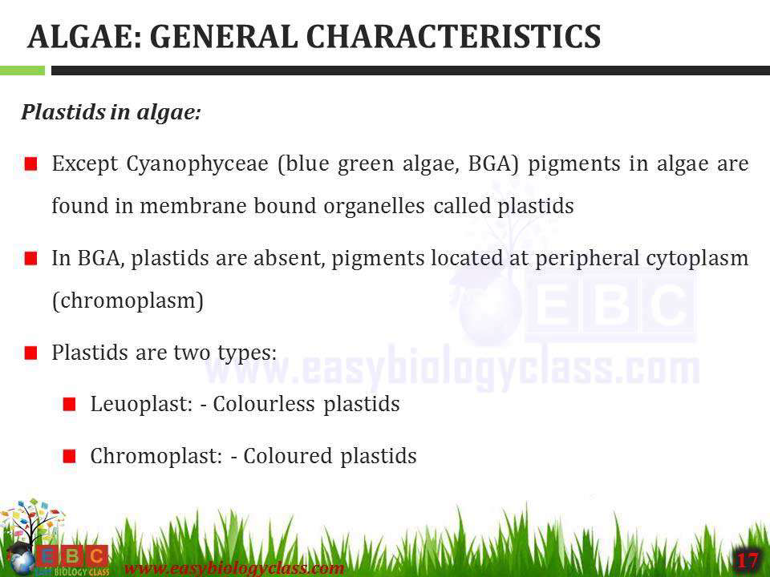
Slide prepared by Dr. D. Barman,Asst professor, Goalpara College

Slide 33
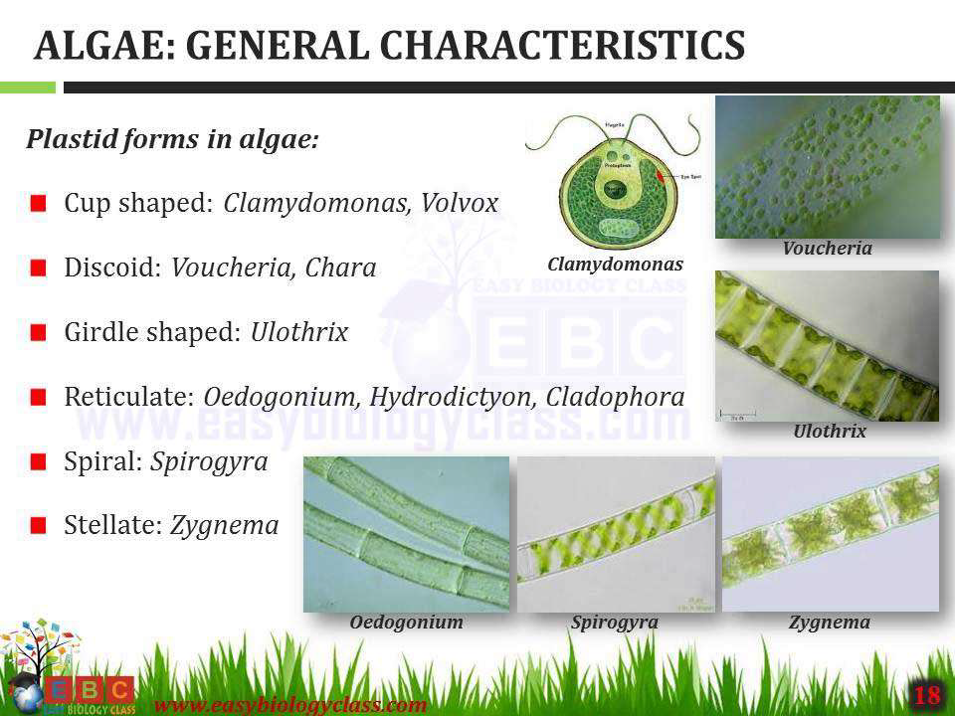
Slide prepared by Dr. D. Barman,Asst professor, Goalpara College

Slide 34
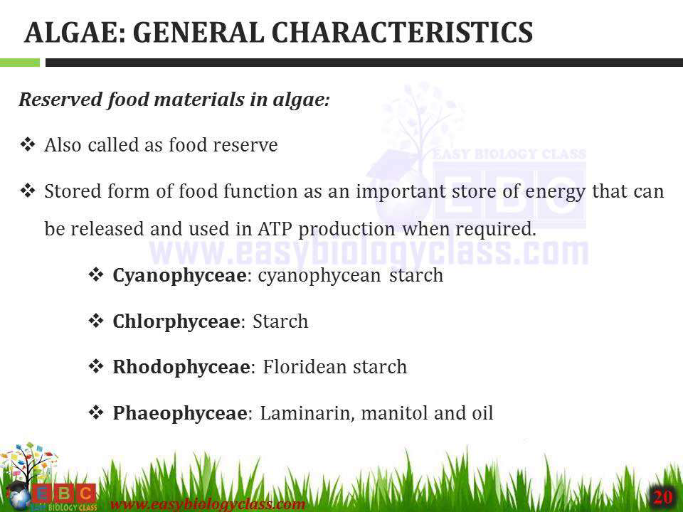
Slide prepared by Dr. D. Barman,Asst professor, Goalpara College

Slide 35


Slide 36


